Slide 1
Packages
Notes:
Schedule: Timing Topic
30 minutes Lecture
30 minutes Total

Slide 2
Objective
  What is Package ?
  Component of package
  Create Package and Referencing Package Contents
  Remove Package

Slide 3
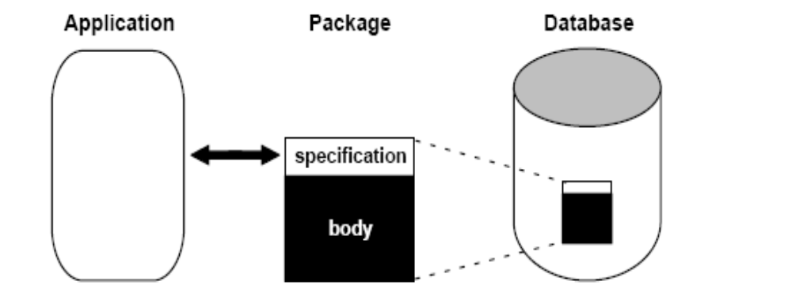
What Is a PL/SQL Package?
  A package is a schema object that groups logically related PL/SQL types, items,and subprograms
  Consist 2 part : specification and body
Notes:
A trigger:
• Is a PL/SQL block or a PL/SQL procedure
associated with a table, view, schema, or the
database
• Executes implicitly whenever a particular event
takes place
• Can be either:
– Application trigger: Fires whenever an event occurs
with a particular application
– Database trigger: Fires whenever a data event (such
as DML) or system event (such as logon or
shutdown) occurs on a schema or database

Slide 4
Advantages of PL/SQL Packages
    Modularity
    Easier Application Design
    Better Performance
    Information Hiding
    Added Functionality

Slide 5
Component of Package
    CREATE [OR REPLACE] PACKAGE package_name
      [AUTHID {CURRENT_USER | DEFINER}]
      {IS | AS}
      [collection_type_definition ...]
      [record_type_definition ...]
      [subtype_definition ...]
      [collection_declaration ...]
      [constant_declaration ...]
      [exception_declaration ...]
      [object_declaration ...]
      [record_declaration ...]
      [variable_declaration ...]
      [cursor_spec ...]
      [function_spec ...]
      [procedure_spec ...]
      [call_spec ...]
    END [package_name];
Notes:
The excessive use of triggers can result in
complex interdependencies, which may be difficult
to maintain in large applications.

Slide 6
Component of Package
    [CREATE [OR REPLACE] PACKAGE BODY package_name {IS | AS}
      [collection_type_definition ...]
      [record_type_definition ...]
      [subtype_definition ...]
      [collection_declaration ...]
      [constant_declaration ...]
      [exception_declaration ...]
      [object_declaration ...]
      [record_declaration ...]
      [variable_declaration ...]
      [cursor_body ...]
      [function_spec ...]
      [procedure_spec ...]
      [call_spec ...]
    [BEGIN
    sequence_of_statements]
    END [package_name];]
Notes:
The excessive use of triggers can result in
complex interdependencies, which may be difficult
to maintain in large applications.

Slide 7
Example about Package : specification
  CREATE OR REPLACE PACKAGE emp_actions AS -- spec
    TYPE EmpRecTyp IS RECORD (emp_id INT, salary REAL);
    CURSOR desc_salary RETURN EmpRecTyp;
    PROCEDURE hire_employee (
        ename VARCHAR2,
        job VARCHAR2,
        mgr NUMBER,
        sal NUMBER,
        comm NUMBER,
        deptno NUMBER);
    PROCEDURE fire_employee (emp_id NUMBER);
  END emp_actions;

Slide 8
Example about Package : body
  CREATE OR REPLACE PACKAGE BODY emp_actions AS -- body
    CURSOR desc_salary RETURN EmpRecTyp IS
    SELECT empno, sal FROM emp ORDER BY sal DESC;
    --------------------
    PROCEDURE hire_employee (ename VARCHAR2,job VARCHAR2,
        mgr NUMBER,sal NUMBER,comm NUMBER,deptno NUMBER) IS
    BEGIN
    INSERT INTO emp VALUES (empno_seq.NEXTVAL, ename, job,mgr, SYSDATE, sal, comm, deptno);
    END hire_employee;
    --------------------
    PROCEDURE fire_employee (emp_id NUMBER) IS
    BEGIN
    DELETE FROM emp WHERE empno = emp_id;
    END fire_employee;
  END emp_actions;

Slide 9
Referencing Package Contents
  package_name.type_name
  package_name.item_name
  package_name.subprogram_name
  package_name.call_spec_name

Slide 10
Overloading Packaged Subprograms
  CREATE PACKAGE journal_entries AS
      PROCEDURE journalize (amount REAL, trans_date VARCHAR2);
      PROCEDURE journalize (amount REAL, trans_date INT);
  END journal_entries;
  CREATE PACKAGE BODY journal_entries AS
      PROCEDURE journalize (amount REAL, trans_date VARCHAR2) IS
      BEGIN
      INSERT INTO journal
      VALUES (amount, TO_DATE(trans_date, ’DD-MON-YYYY’));
      END journalize;
      PROCEDURE journalize (amount REAL, trans_date INT) IS
      BEGIN
      INSERT INTO journal
      VALUES (amount, TO_DATE(trans_date, ’J’));
      END journalize;
  END journal_entries;

Slide 11
Remove Package
  Remove package specification
  Drop package package_name;
  Remove package body
  Drop package body package_name;

Slide 12
Overview of Product-Specific Packages
  DBMS_ALERT
  DBMS_OUTPUT
  UTL_FILE
  UTL_HTTP
  ...

Slide 13
Summary
  Package
  Component of package
  Create Package and Referencing Package Contents
  Remove Package
Notes:
Summary
PL/SQL is a language that has programming features that serve as an extension to SQL. It provides control-of-flow constructs and lets you declare and use variables. PL/SQL applications can run on any platform and operating system on which Oracle runs.

